Slide 1
Product Sales Analysis Project 2
File created on: 7/22/2023 10:53:13 AM

Slide 2
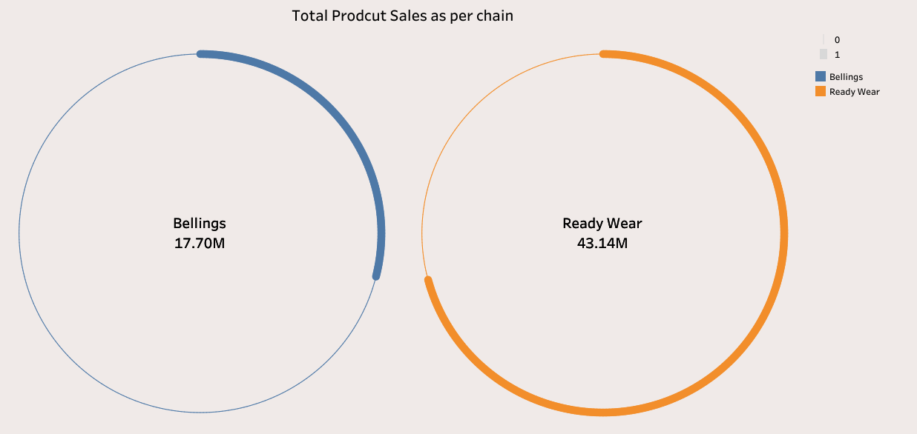

Slide 3
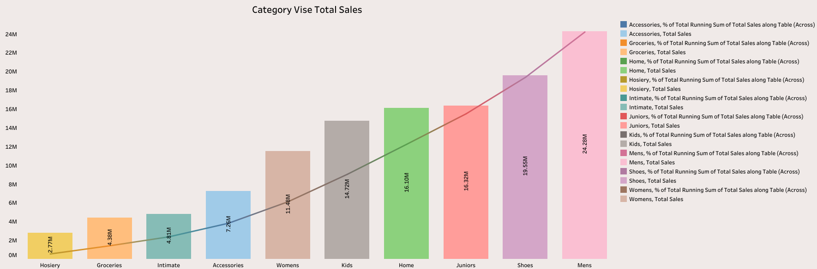

Slide 4
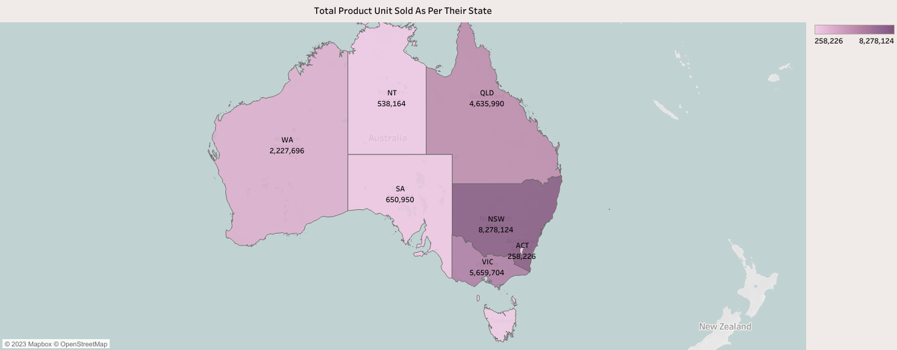

Slide 5
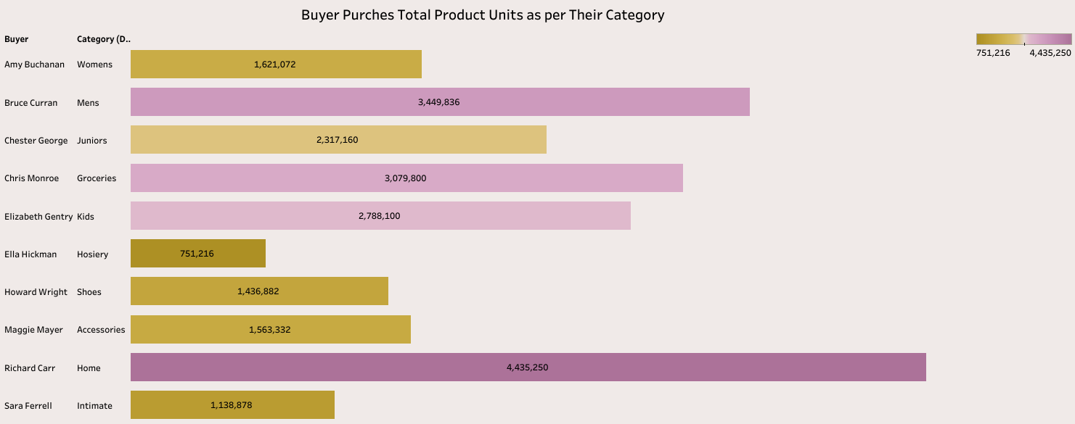

Slide 6
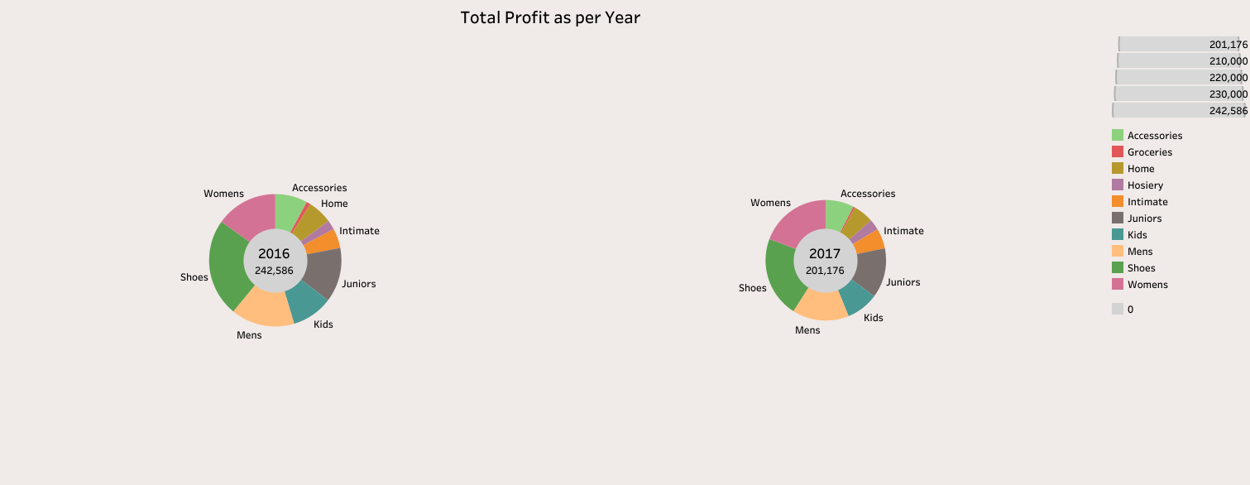

Slide 7


Slide 8


Slide 9


Slide 10
